Slide 1
Software Testing
August 27, 2021
Gene De Guzman

Slide 2
Introduction
Who is the speaker?

Slide 3

Introducing the speaker...
1st Job Maintenance Developer (Bootcamp/Green Bean) from ERP Company (L3 Support).
Handled bug fixing and enhancement request for certain module.
Did Test automation.
Fun facts:
Mahilig humugot (tested and proven)
Nakakatulog sa byahe pero never lumagpas
It’s me 4 months ago

Slide 4
Let’s get this started
Please like and subscribe to TechTok! ☺

Slide 5
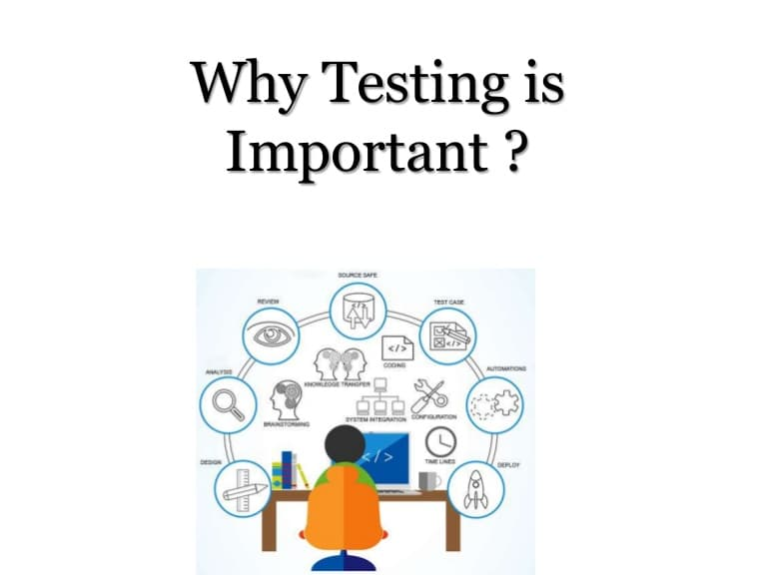

Slide 6

Let’s put it in this scenario...

Slide 7
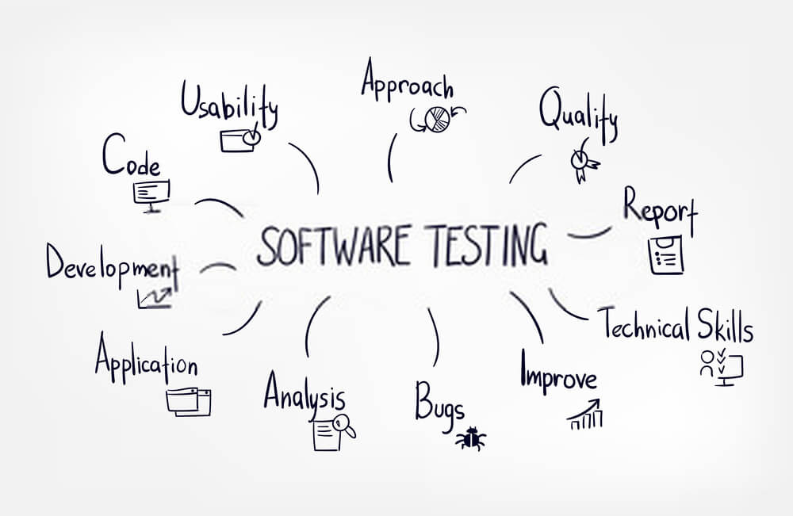

Slide 8
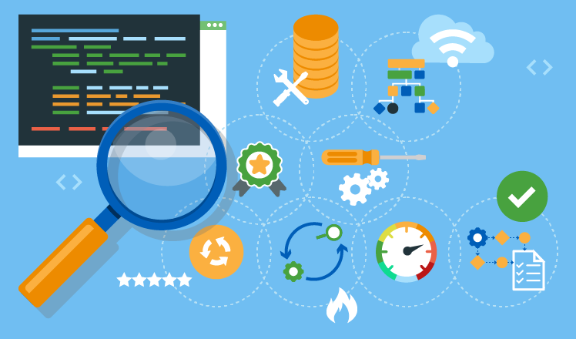
Software Testing is a method to check whether the actual software product matches expected requirements and to ensure that software product is Defect free

Slide 9






What if...

Slide 10


Slide 11
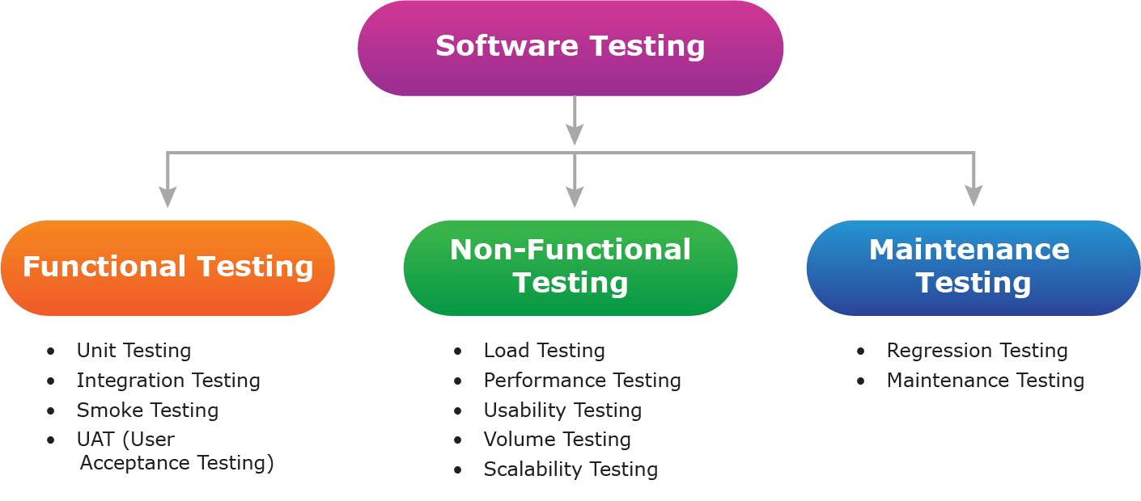
SDEM Phase:
PT and IT

Slide 12
PT Phase:
PT1(JUnit)
or
PT2(Scenario Based)
IT Phase

Slide 13
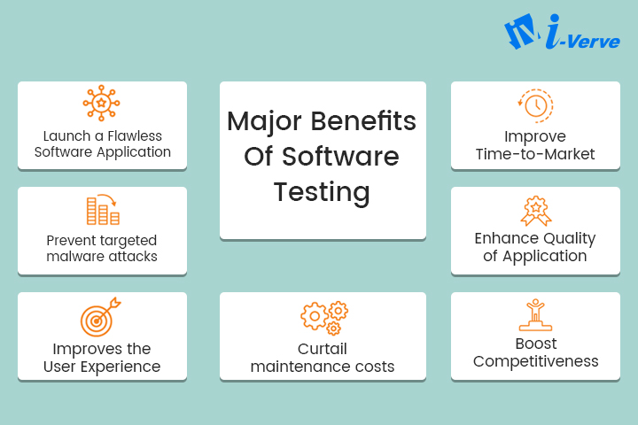

Slide 14
Summary
Testing is important because software bugs could be expensive or even dangerous.
The important are reasons for using software testing are: cost-effective, security, product quality, and customer satisfaction.
Typically Testing is classified into three categories functional testing, non-functional testing or performance testing, and maintenance.
The important strategies in software engineering are: unit testing, integration testing, validation testing, and system testing.
Source: https://www.guru99.com/software-testing-introduction-importance.html

